Slide 1
5 The Relational Algebra and Relational Calculus (5 Hrs)
Unary Relation Operations: SELECT and PROJECT; Relational Algebra Operations Theory, Binary Relational Operations: JOIN and DIVISION; Additional Relational Operations; The Tuple Relational Calculus; The Domain Relational Calculus

Slide 2
Query Languages
A query language is a language in which a user requests information from the database.
Query languages can be either procedural or non-procedural
In a procedural languages the user instructs the system to perform a sequence of operations on the database to compute the desired result: Relational Algebra
In non-procedural languages, the user describes the desired information without giving a specific procedure for obtaining that information: Example: tuple relational calculus and domain relational calculus, SQL etc

Slide 3
Relational Algebra
Relational algebra is a procedural query language, which takes instances of relations as input and yields instances of relations as output.
It takes operators to perform queries. An operator can be either unary or binary
Recursive operations are allowed in relational algebra.
Historically, the relational algebra and calculus were developed before SQL language.
SQL is primarily based on concepts from relational calculus and has been extended to incorporate some concepts from relational algebra as well.

Slide 4
Relational Algebra
Relational algebra is very important for several reasons
It provides a informal foundation for relational model operations
It is used as basis for implementing and optimizing queries in query processing and optimization modules that are integral parts of relational database management system.
Some of its concepts are incorporated into SQL for RDBMS[Most commercial RDBMSs do not provide user interface for relational algebra, the core operations and functions in the internal modules of most relational systems are based on relational algebra operations]

Slide 5
Operations on Relational Algebra
Unary Relational Operations
Binary Relational Operations
Relational Algebra Operations from set theory
Additional Relational Operations

Slide 6
Operations on Relational Algebra
Unary Relational Operations
Select Operation(Symbol :σ)
Project Operation (Symbol:π)
Rename Operation(Symbol:ρ)

Slide 7
Operations on Relational Algebra
Binary Relational Operations
Join Operation (Symbol: )
Division Operation (symbol % )

Slide 8
Operations on Relational Algebra
Relational Algebra Operations from set Theory
Union Operation ( )
Intersection Operation ( )
Difference Operation ( )
Cartesian Product Operation ( )

Slide 9
Operations on Relational Algebra
Additional Relational Operations
Assignment Operation
Generalized Projection
Aggregate Functions
Null Values

Slide 10
Unary Relational Operations
The relational algebra operations that uses single relation (table) are called unary relational operations
There are three unary operations
Select Operation
Project Operation
Rename Operation

Slide 11
Unary Relational Operations
SELECT Operation (σ ): The select operation is used for selecting a subset of the tuples according to a given selection condition.
We can consider the SELECT operation to be a filter that keeps only those tuples that satisfy a qualifying condition.
Syntax:
σ <selection-condition>( R )
Where R stands for Relation which is the name of table

Slide 12
Unary Relational Operations
Comparison operators (<,<=,>,>= !=) can be used to specify conditions required for selecting tuples from a relation.
Furthermore, logical operators AND(^) , OR( v) and NOT(-) can be used to combine two or more relation
Example: Select all employee whose salaries is higher than 45000 and department number is 4
σ dno=4 ^salary>45000 (EMPLOYEE)

Slide 13
Example
Stu_Id | Stu_name | Stu_Address | Dept_Id | Age
10 | Maya | Palpa | 1 | 22
11 | Abin | ktm | 2 | 17
12 | Aarav | ktm | 1 | 21
13 | Astha | Palpa | 3 | 45
14 | Anuj | Pokhara | 4 | 23
15 | Manish | Banepa | 5 | 23

Slide 14
Example
Ex1: Find records of all students of address ‘Palpa’
σ stu_address = “palpa”(Student)
Ex2: Find all students whose address is “ktm” and department is 1
σ stu_address = “ktm”^ dept_id=1(Student)
Ex3: Find all students of age greater than 20 or of address ‘ktm’
σ age>20 v stu_address = “ktm”(Student)

Slide 15
Unary Relational Operations
PROJECTION Operation (π): The PROJECT operation is used to select certain columns from the table and discards the other columns.
When we are interested in only certain attributes of a relation, we use the PROJECT Operation to project the relation over those attributes only.
Syntax: π <attribute-list> ( R )
Example: Display name and salary of EMPLOYEE
π(name, salary)(EMPLOYEE)

Slide 16
Examples
Ex1: Display id and name of student
π stu_id, stu_name (Student)
Ex2: Display name and age of students
π stu_name, age (Student)

Slide 17
Combining Selection and Projection Operations
The selection and projection operations can be combined to perform projection with selection operation. The inner operation is performed first then outer operation is performed
Syntax: π <attribute list>(σ <selection condition>)( R )
Ex1: Find name and age of students whose age is less than or equal to 25
π <stu_name, age>(σ <age<=25>)( Student )
Ex2: Find name of students whose age is greater than 20 and address is ‘Palpa’
π <stu_name>(σ < age>25^ stu_address=‘palpa>)( Student )

Slide 18
Rename Operation(ρ)
The rename operation is used to rename either the relation or the attribute names or both.
The general rename operation when applied to a relation R of degree n is denoted by any of the following three forms:
ρ S(B₁,B₂…B_{n}) ( R )
ρ S( R)
ρ (B₁, B₂, B₃, …..B_{n}) ( R )
where the symbol ρ (rho) is used to denote the RENAME operator, S is the new relation name and B₁,B₂…B_{n} are the new attribute names

Slide 19
Rename Operation(ρ)
The first expression renames both the relation and its attributes, the second renames the relation only and the third renames the attributes only.
If the attributes of R are (A₁, A₂, A₃….A_{n}) in that order then each A_{i} is renamed as B_{i}

Slide 20
Relational Algebra Operations From Set Theory
All of the operations except Cartesian product set operation take two input relations and produce single output relation.
The input relations must be union-compatible:
Same number of fields (attributes)
Corresponding fields have the same type.
That is, the two relations must have same number of attributes and each corresponding pair of attributes has the same domain.

Slide 21
UNION Operation
Let R and S be two relations. The union of relations R and S is denoted by R U S and it is the set of tuples that are either in R and in S or in both type. Duplicate tuples are eliminated
Formally, we define union as below:
RUS = {t | t ∈ R or t ∈ S} where R and S are any two relations and t is a tuple

Slide 22
Example
Ex: Let us consider two relations namely morning shift employee as “Memployee” and day shift employee as “Demployee”.
Memployee Demployee
eid | name | salary
e1 | Rajan | 34000
e2 | Aarav | 45000
e3 | Abin | 55000
e4 | Ashna | 44000
eid | name | salary
e1 | Rajan | 34000
e5 | Umesh | 78000
e8 | Anisha | 55000
e4 | Ashna | 44000

Slide 23
Example
Memployee U Demployee
eid | Name | Salary
e1 | Rajan | 34000
e2 | Aarav | 45000
e3 | Abin | 55000
e4 | Ashna | 24000
e5 | Umesh | 78000
e8 | Anisha | 55000

Slide 24
Intersection Operation(∩)
Set intersection is denoted by symbol ∩ and it returns a relation that contains tuples that are in both of its argument relations.
The intersection of relations R and S is denoted by R ∩ S is defined as:
R ∩ S = { t | t ∈ R and t ∈ S }
Note: R and S are union capatible

Slide 25
Example
Memployee ∩ Demployee
eid | name | Salary
e1 | Rajan | 34000
e4 | Ashna | 24000

Slide 26
Set Difference Operation(-)
Set difference operation is denoted by minus sign (-). It finds tuples that are in one relation but not in another.
The set difference of two relations R and S is denoted by R-S and is denoted as,
R-S = { t | ∈ R and t ∉S}
R-S results in a relation containing tuples that are in R but not in S

Slide 27
Example:
Memployee - Demployee
eid | name | salary
e2 | Aarav | 45000
e3 | Abin | 55000

Slide 28
Cartesian Product or Cross Join
Cartesian Product is also binary set operation but the relations on which it is applied do not have to be union compatible.
This operation is used to combine tuples from two relation in a combinatorial fashion.
In general, the result of R(A₁,A₂,…A_{n}) X S(B₁,B₂,..B_{m}) is a relation Q with degree n+m attributes Q(A₁,A₂…A_{n},B₁…B_{m}) in that order.
The resulting relation Q has one tuple for each combination of tuples –one from R and one From S

Slide 29
Cross Join(Cartesian Product)
If there are m rows in first table and there are n row in the second table then there are m*n rows.
The Cartesian product of two relations R and S is denoted by RXS, is the set of all possible combinations of tuples of the relations.
Formally, we can define Cartesian product as:
RXS = {tq|t ∈ R and q ∈ S }
Where R and S are any two relations and t and q are tuples of relation R and S respectively

Slide 30
Let us take two relations Staff and
Department as follows
Department
Dept_id | Dept_name | Dept_block_no
1 | Computer | 100
2 | Mathematics | 200
3 | Economics | 300
4 | Account | 400
5 | Physics | 500
Staff
Staff_id | Staff_name | Dept_id
11 | Mohan | 1
22 | Pratima | 2

Slide 31
The Cartesian product of Department and Staff
D.Dept_id | Dept_name | Dept_block_no | Staff_id | Staff_name | S.dept_id
1 | Computer | 100 | 11 | Mohan | 1
1 | Computer | 100 | 22 | Pratima | 2
2 | Mathematics | 200 | 11 | Mohan | 1
2 | Mathematics | 200 | 22 | Pratima | 2
3 | Economics | 300 | 11 | Mohan | 1
3 | Economics | 300 | 22 | Pratima | 2
4 | Account | 400 | 11 | Mohan | 1
4 | Account | 400 | 22 | Pratima | 2
5 | Physics | 500 | 11 | Mohan | 1
5 | Physics | 500 | 22 | Pratima | 2
Department X Staff

Slide 32
Binary Relational Operations
Join Operation: Join operation, denoted by ⋈,is used to combine related tuples from two different relations into a single type.
This operation is very important for any relational database with more than single relation, because it allows us to process relationships among relations.
For example, suppose we have to retrieve the name of manager of each department. To get the manager name, we need to combine each department tuple with the employee tuple whose ssn value matches the mgssn value in the department tuple.
We do this by using the JOIN operations.

Slide 33
The Join Operation
It can be said that it is similar to Cartesian product except the fact that in Cartesian product, we get all the possible combinations of relations while in join only those combinations can be formed that satisfies some matching conditions.
A Cartesian product followed by a selection process results in join. In RA join operation is denoted by ⋈

Slide 34
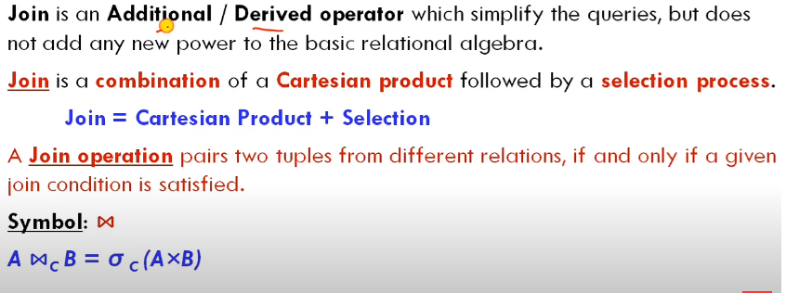
JOIN Operations

Slide 35
Types of Join
There are two types of JOIN Operations
Inner Join
Outer Join
Inner Join are three types
Theta (θ) Join
Equi-Join
Natural Join

Slide 36
Inner Join(JOIN)
Inner join is the simplest and most common type of join.
It is also called Simple Join.
An INNER JOIN is such type of join that returns all rows from the participating tables where the key record of one table is equal to the key records of another table.
This type of join requires a comparison operator to match rows from the participating tables based on field or column of the both the tables.

Slide 37

Inner Join

Slide 38

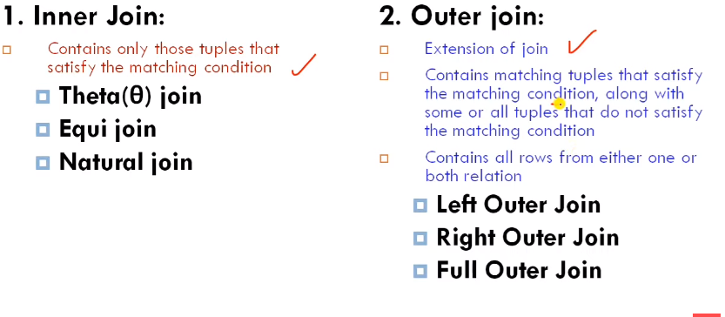
JOIN

Slide 39
Let us consider the following two relations
Department
Dept_id | Dept_name | Dept_block_no
1 | Computer | 100
2 | Mathematics | 200
3 | Economics | 300
4 | Account | 400
5 | Physics | 500
Staff
Staff_id | Staff_name | Dept_id
11 | Mohan | 1
22 | Pratima | 2
33 | Madan | 1
44 | Kamala | 3
55 | Sandhya | 4
66 | Umesh | 3
77 | Ramesh | 1

Slide 40
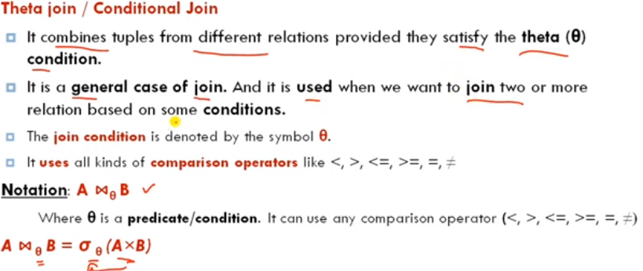
Theta Join

Slide 41
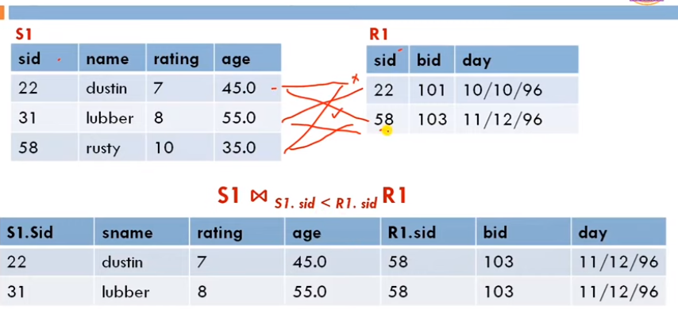
Theta Join Example

Slide 42
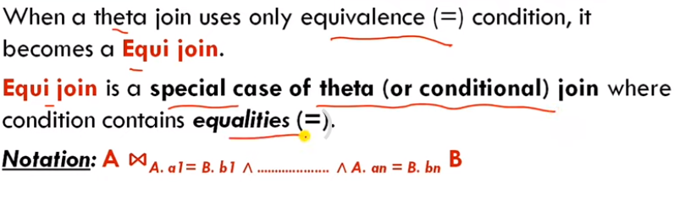
Equi-Join

Slide 43
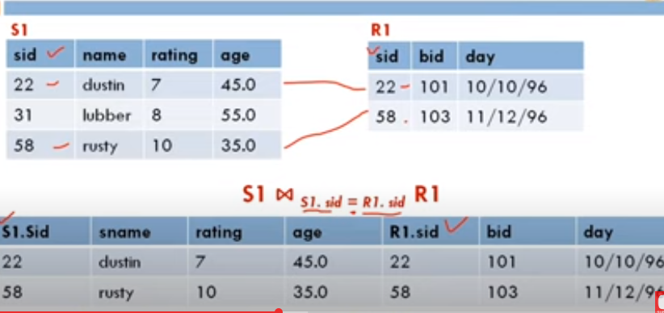
Equi Join Example

Slide 44
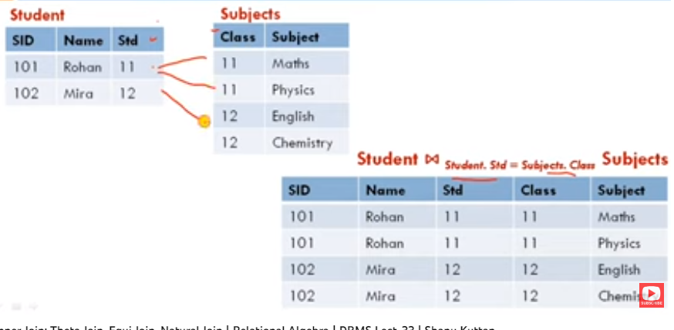
Example 2

Slide 45
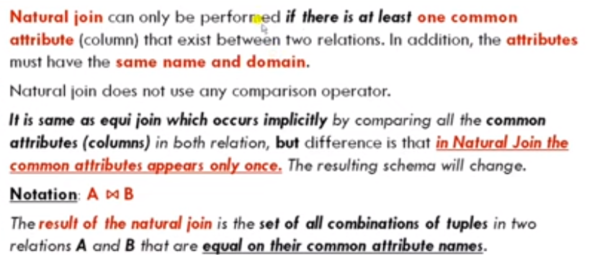
Natural Join

Slide 46
Natural Join
Natural Join does not use any comparison operators. It does not concatenate the way a Cartesian product does.
We can perform a natural join only if there is at least one common attribute that exists between two relations.
In addition, the attribute must have same name and domain
Natural join acts on those matching attributes where the values in both the relations are same.

Slide 47
Let us consider the following two relations
Department
Dept_id | Dept_name | Dept_block_no
1 | Computer | 100
2 | Mathematics | 200
3 | Economics | 300
4 | Account | 400
5 | Physics | 500
Staff
Staff_id | Staff_name | Dept_id
11 | Mohan | 1
22 | Pratima | 2
33 | Madan | 1
44 | Kamala | 3
55 | Sandhya | 4
66 | Umesh | 3
77 | Ramesh | 1

Slide 48
Natural Join(Department ⋈ Staff)
Dept_id | Dept_name | Dept_block_no | Staff_id | Staff_name
1 | Computer | 100 | 11 | Mohan
1 | Computer | 100 | 33 | Madan
1 | Computer | 100 | 77 | Ramesh
2 | Mathematics | 200 | 22 | Pratima
3 | Economics | 300 | 44 | Kamala
3 | Economics | 300 | 66 | Umesh
4 | Account | 400 | 55 | Sandhya

Slide 49
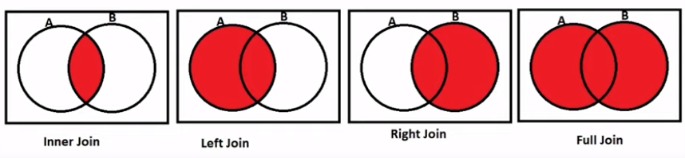
Join Operations

Slide 50
Outer Join
An Outer Join is similar to equijoin but it gets also the non-matched rows from the table.
It is a join in which tuples from R that do not have matching values in the common attributes of S are also included in the result relation. The missing values in the second relation are set to null
It is categorized as
Left Outer Join
Right Outer Join
Full Outer Join

Slide 51
Left Outer Join
Left Outer Join return all rows from left (first) table specified in the ON condition and only those rows from the right (second) table where the join condition is met and set NULL to the unmatched rows of second table
The following table shows Left Outer Join of relation Department and Staff

Slide 52
Let us consider the following two relations
Department
Dept_id | Dept_name | Dept_block_no
1 | Computer | 100
2 | Mathematics | 200
3 | Economics | 300
4 | Account | 400
5 | Physics | 500
Staff
Staff_id | Staff_name | Dept_id
11 | Mohan | 1
22 | Pratima | 2
33 | Madan | 1
44 | Kamala | 3
55 | Sandhya | 4
66 | Umesh | 3
77 | Ramesh | 1

Slide 53
Dept_id | Dept_name | Dept_block_no | Staff_id | Staff_name | Dept_id1
1 | Computer | 100 | 11 | Mohan | 1
1 | Computer | 100 | 33 | Madan | 1
1 | Computer | 100 | 77 | Ramesh | 1
2 | Mathematics | 200 | 22 | Pratima | 2
3 | Economics | 300 | 44 | Kamala | 3
3 | Economics | 300 | 66 | Umesh | 3
4 | Account | 400 | 55 | Sandhya | 4
5 | Physics | 500 | NULL | NULL | NULL
Result of Department ⟕ Staff

Slide 54
Right Outer Join
The Right Outer Join returns a result set table with the matched data from the two tables being joined, then the remaining rows of the right table and null for the remaining left table’s columns.
The following table shows the Right Outer Join of relation Department and Staff

Slide 55
Staff_id | Staff_name | Dept_id | Dept_id1 | Dept_name | Dept_block_no
11 | Mohan | 1 | 1 | Computer | 100
33 | Madan | 1 | 1 | Computer | 100
77 | Ramesh | 1 | 1 | Computer | 100
22 | Pratima | 2 | 2 | Mathematics | 200
44 | Kamala | 3 | 3 | Economics | 300
66 | Umesh | 3 | 3 | Economics | 300
55 | Sandhya | 4 | 4 | Account | 400
NULL | NULL | NULL | 5 | Physics | 500
Result of Staff ⟖ Department

Slide 56
Full Outer Join
The FULL OUTER JOIN returns a result set that includes rows from both left and right tables.
When no matching rows exist for the row in the left table, the columns of the right table will have NULLs.
Similarly, when no matching rows exist for the row in the right table, the column of the left table will have NULLs
The following table shows FULL OUTER JOIN of relation
Department and Staff

Slide 57
Dept_id | Dept_name | Dept_block_no | Staff_id | Staff_name | Dept_id1
1 | Computer | 100 | 11 | Mohan | 1
1 | Computer | 100 | 33 | Madan | 1
1 | Computer | 100 | 77 | Ramesh | 1
2 | Mathematics | 200 | 22 | Pratima | 2
3 | Economics | 300 | 44 | Kamala | 3
3 | Economics | 300 | 66 | Umesh | 3
4 | Account | 400 | 55 | Sandhya | 4
5 | Physics | 500 | NULL | NULL | NULL
Result of Department ⟗ Staff

Slide 58
Division Operation(÷)
The division operation, denoted by symbol ( ÷), is useful for a special kind of query that some times occurs in database applications especially includes the phrase “for all”.
It takes two relations and builds another relation, consisting of values of an attribute of one relation that match all values in the other relation.

Slide 59
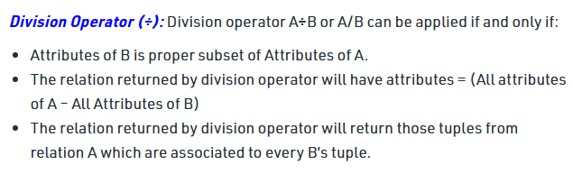
Division Operation

Slide 60
The Division Operation
In general, The Division operation is applied to two relations R(Z) ÷ S(X) where X subset of Z.
Let Y be the set of attributes of R that are not attributes of S. The set of attributes in R(Z) ÷ S(X) is Y.
The result of Division is a relation T(Y) that includes a tuple t if tuple T_{R} appear in R with t_{R}(Y) = t and with t_{R}(X) = t_{S} for every t_{S} in S.
This means that, for a tuple t to appear in the result T of the division, the values in t must appear in R in combination with every tuple in S.

Slide 61
Division Operation Example
Sno | pno
S1 | P1
S1 | P2
S1 | P3
S1 | P4
S2 | P1
S2 | P2
S3 | P2
S4 | P2
S4 | p4
Pno
P2
Pno
P2
P4
Pno
p1
p2
p4
B1
B2
B3
A

Slide 62
Division Operation Example
sno
S1
S2
S3
S4
sno
S1
S4
sno
S1
A%B2
A%B3
A%B1

Slide 63
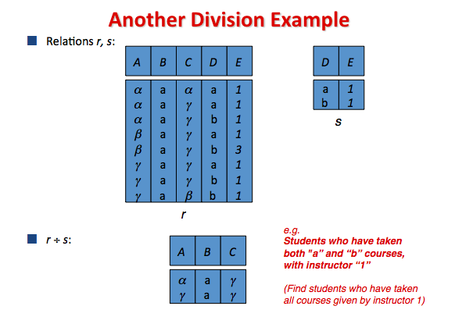

Slide 64
Example
Player_Name | Venue_name
Joe | XYZ
Joe | ABC
Jim | PQR
Tom | ABC
Joe | LPM
Joe | PQR
Sem | ABC
Venue_name
XYZ
PQR
ABC
LPM
R₂
Player_Name
Joe
R1%R2
R₁

Slide 65
Additional Relational Operations
Some common database requests which are needed in commercial applications for RDBMS can not be performed with the original relational algebra operations.
So we need some additional operations to express these requests.
These operations enhance the expressive power of the original relational algebra.

Slide 66
Generalized Projection
The generalized projection operation extends the projection operation by allowing functions of attributes to be included in the projection list.
The generalized form of projection can be expressed as
Π _{F1,F2,F3…..Fn} ( R )
Where F₁,F₂….F_{n} are functions over the attributes in relation R and may involve arithmetic operations and constant values.
This operation is useful when developing reports where computer values have to be produced in the columns of a query result

Slide 67
Example
EID | Name | Age | Salary
e1 | Rajan | 33 | 34000
e2 | Aarav | 17 | 45000
e3 | Abin | 22 | 55000
e4 | Ashna | 19 | 24000
e5 | Mohan | 30 | 33000
e6 | Dipak | 26 | 78000
e7 | Sarmila | 28 | 55000

Slide 68
Examples
Ex1: Find names and salary of all employees by increasing their salary by 15 %
Π _{name, salary = salary*1.15} (Employee)
Ex2: Increase the salary of employees whose age are greater than 20 by 5%
Π eid, name, age, salary = salary*1.05 (σ_{age}>20(Employee)

Slide 69
The Assignment Operation
The assignment operation (←) provides a convenient way to express complex queries in a series of simple expressions.
Syntax:
Variable← E, where E is any relational algebra expression.
Example: Let us take two relations borrower and depositor in bank database. We have to find all customer who have taken loan from bank as well as he or she has bank account.

Slide 70
The Assignment Operation
The assignment operation takes following form:
temp₁← π customer_name (borrower)
temp₂← π customer_name (depositor)
result← temp₁ ∩ temp₂
1-<number>

Slide 71
Database Manipulation
We use three types of operations for the modification of the database;
They are insertion, deletion and modification

Slide 72
Insertion Operation
To insert data into a relation , we specify a tuple to be inserted.
Syntax:
R← R U E
Where R is a relation and E is a relational algebra expression
Example: Let us suppose we have a relation Employee(name, Salary, Address). And suppose we want to insert an employee “Kamal” of salary 4000 and having address “Kathmandu” Then we write
Employee ← Employee U {“Kamal”,5000, “Kathmandu”)

Slide 73
Deletion Operation
We can remove the selected tuples from the database. We cannot delete values of only particular attributes.
Here we use assignment operator and set difference operator to perform deletion operation in RA.
Syntax:
R ← R-E
Here R is relation and E is a relational expression

Slide 74
Deletion Operation
Example: Delete employee ‘Anuj’ from Employee relation
eid | ename | salary
11 | Anuj | 40000
12 | Aman | 30000
13 | Manju | 45000
14 | Anil | 34000
15 | Bimal | 31000
Employee← Employee - σename = “Anuj(Employee)

Slide 75
Deletion Operation
Result:
eid | ename | salary
12 | Aman | 30000
13 | Manju | 45000
14 | Anil | 34000
15 | Bimal | 31000

Slide 76
Update Operation
In some situation we may wish to change a value in tuple without changing all values in the tuple.
We can use the generalized-projection operator to do this task.
Syntax: π <A₁,A₂,….A_{n}>(Relation)
where A₁, A₂…A_{n} are attributes

Slide 77
Update Operation
Example: Increase the salary of employee by 15% working in department “ computer”
eid | ename | department | Salary
11 | Kamal | Computer | 3000
12 | Bimal | Mathematics | 4000
13 | Sunil | Physics | 5000
14 | Binita | Computer | 6000
15 | Sunita | Mathematics | 6400

Slide 78
Update Operations
Employee ← (π eid, ename, department , salary+salary*0.15(
σ department = ‘computer’(Employee)) U
(π eid, ename, department, salary(
σ department ≠‘computer’(Employee)))

Slide 79
Update Operation
Updated Employee
eid | ename | department | Salary
12 | Bimal | Mathematics | 4000
13 | Sunil | Physics | 5000
14 | Binita | Computer | 6000
15 | Sunita | Mathematics | 6400

Slide 80
Aggregate Functions
Aggregate functions are algebraic functions that take a collection of values as input and return a single value as a result.
It is denoted by G and read as calligraphic G.
The general of aggregate operations in relational algebra is:
G₁,G₂,……..G_{n} G F₁(A₁), F₂(A₂)…,F_{n}(A_{n})( E )
Where E is any relational algebra expression
G₁, G₂,….G_{n} is a list of attributes on which to group (can be empty).
Each F_{i} is an aggregate function and each A_{i} is an attribute name

Slide 81
Aggregate Functions
Aggregate functions are deterministic. That is, aggregate functions return the same value any time that they are called by using a specific set of input values.
We can not express aggregate functions by using basic relational algebra expressions.
There are five aggregate functions that are included with most relational database systems. These operations are:
SUM : Sum of values
AVG : Average value
MIN : Minimum value
MAX: Maximum value
COUNT: Number of values

Slide 82
Example: Consider an employee relation
EID | NAME | ADDRESS | AGE | Salary
e₁ | Rajan | Ktm | 33 | 34000
e₂ | Aarav | Pokhara | 17 | 45000
e₃ | Abin | Palpa | 22 | 55000
e₄ | Ashna | Ktm | 19 | 24000
e₅ | Manmohan | Pokhara | 30 | 33000

Slide 83
Queries
Example 1: Find total number of employees
G count( Eid ) ( Employee )
Example 2: Find average age of employees having address ‘ktm’
G AVG(σ Address = ‘Ktm’)(Employee))
Example 3: Find minimum and maximum age of the student
G min(age), Max(age) (Employee)
1-<number>

Slide 84
Example 4: Find average salary of employee in each address level
Address G AVG(salary)(Employee)
Example 5: Find total salary of the employee
G sum(salary)( Employee)

Slide 85
NULL Values
We consider following three cases to understand NULL.
Unknown Value: A person’s date of birth is not known, so it is represented by NULL in the database
Unavailable : A person has a home phone but does not want it to be listed so it is withheld and represented as NULL in the database.
Not Applicable Attribute: An attribute LastCollegeDegree would be NULL for a person who has no college degree because it does not apply to that degree
It is often not possible to determine which of the meanings is intended. For example, a NULL for the home phone of a person can have any of the three meanings. In general, each individual NULL value is considered to be different from every other NULL value in the various database records.

Slide 86
NULL Values
NULL represents value for an attribute that is currently unknown or not applicable for the tuples.
It deals with incomplete or exceptional data .
It represents the absence of a value and is not the same as zero or spaces which are values.
The result of any arithmetic expression involving NULL is NULL.
Aggregate functions simply ignore null values
For duplicate elimination and groupings, NULL is treated like any other value, and two NULLs are assumed to be the same
Comparisons(such as <.<=,>,>=,=,!=) with NULL values return the special truth value unknown.

Slide 87
NULL Values
Two-valued logic is straight forward and we are well known about it.
Comparisons involving NULL may occur inside Boolean expressions involving the AND, OR and NOT operations. We must therefore define how the three Boolean operations deal with the truth value unknown.
AND : TRUE AND UNKNOWN = UNKNOWN
FALSE AND UNKNOWN = FALSE
UNKNOWN AND UNKNOWN = UNKNOWN

Slide 88
NULL Values
OR : TRUE OR UNKNOWN = TRUE
FALSE OR UNKNOWN = UNKNOWN
UNKNOWN OR UNKNOWN = UNKNOWN
NOT : (NOT UNKOWN) = UNKNOWN

Slide 89
Relational Calculus
Relational Calculus is a non-procedural query language.
It uses mathematical predicate calculus instead of algebra.
It provides the description about the query to get the result where as relational algebra gives the method to get the result.
It informs the system what to do with the relation, but does not inform how to perform it. Relational calculus exists in two forms:
Tuple Relational Calculus ( TRC )
Domain Relational Calculus (DRC)

Slide 90
The Tuple Relational Calculus
The tuple relational calculus is a nonprocedural query language. It describes the desired information without giving a specific procedure for obtaining that information
Tuple relational calculus is used for selecting those tuples that satisfy the given condition.
It is a logical language with variables ranging over tuples.
A query in the tuple relational calculus is expressed as
{t | P(t)} or {t | condition (t) }
Where t is the resulting tuples, P(t) is the condition used to fetch t

Slide 91
The Tuple Relational Calculus
In tuple relational calculus, we define a tuple variable; specify the relation name in which the tuple is to be searched for, along with a condition. We can also specify name using a dot operator, with the tuple variable to get a certain attribute in result.
Example 1: {t | EMPLOYEE (t) and t.Salary>1000)
Implies that it selects the tuples from EMPLOYEE relation such that resulting employee tuples will have salary greater than 10000.
Example 2: {t| EMPLOYEE(t) AND t.Dept_Id =10}:
This selects all the tuples of employee who work for department 10

Slide 92
The Tuple Relational Calculus
The condition EMPLOYEE(t) specifies that the range relation of tuple variable t is EMPLOYEE. Each EMPLOYEE tuple t that satisfies the condition t.salary>1000 will be retrieved.
To retrieve only some of the attributes, say first and last name , we write
{ t.Fname, t.Lname | EMPLOYEE(t) AND t.salary > 5000 }
We need to specify the following information in a tuple relational calculus expression:

Slide 93
The Tuple Relational Calculus
For each tuple variable t, the range relation R of t. This value is specified by a condition of the form R(t).
A condition to select particular combinations of tuples. As tuple variables range over their respective range relations, the condition is evaluated for every possible combination of tuples to identify the selected combinations for which the condition evaluates to TRUE
A set of attributes to be retrieved, the requested attributes. The values of these attributes are received for each selected combination of tuples.

Slide 94
The Tuple Relational Calculus
Query: Retrieve the birth date and address of the employee whose name is John B. Smith
:
{t.Bdate, t.Address | Employee(t) AND t.Fname = ‘John’ AND t.Minit =‘B’ and t.Lname = ‘Smith’ }

Slide 95
The Domain Relational Calculus
In contrast to tuple relational calculus, domain relational calculus uses list of attributes to be selected from the relation based on the condition.
It is same as TRC but differs by selecting the attributes rather than selecting whole tuples. It is denoted as below:
{<a₁,a₂….a_{n}>|P(a₁,a₂,…a_{n})}
Where a₁,a₂…a_{n} are attributes of the relation and P is the condition.

Slide 96
The Domain Relational Calculus
Example:
{<name, age> |<sid, name, age> ∈ student ^ age>17 }
This query will return the names and ages of the students in the table student who are older than 17

Slide 97
